Slide 1
Coursera Capstone Presentation
Coursera IBM Data Science Certification
RIZA YILDIRIM
January 2020

Slide 2
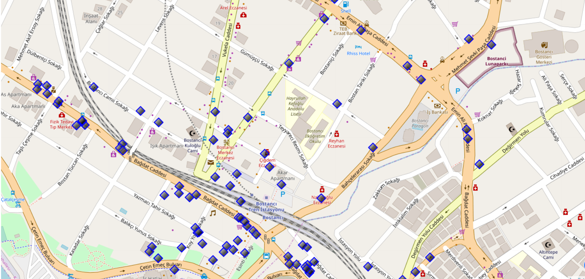
Execution and Results Current residence Neighborhood in Istanbul

Slide 3
Venues around Neighborhood
 | name | categories | lat | lng
0 | Cebecizade Türk Kahvesi | Café | 40.955631 | 29.097338
1 | Dondurmacı Yaşar Usta | Ice Cream Shop | 40.957193 | 29.097021
2 | Beşa Cafe | Café | 40.957551 | 29.097264
3 | Çaykur Çaykolik | Tea Room | 40.954341 | 29.094894
4 | Studyo pilates | Athletics & Sports | 40.958013 | 29.096092
5 | Bakıroğlu Gurme | Breakfast Spot | 40.957768 | 29.097471
6 | Tarihi Şen Lokanta | Turkish Home Cooking Restaurant | 40.954965 | 29.094332
7 | Bostancı Balık | Seafood Restaurant | 40.954465 | 29.095689
8 | Ekler İstanbul Bostancı | Dessert Shop | 40.957705 | 29.096905
9 | 1A Meyhanesi | Bar | 40.955151 | 29.094691

Slide 4
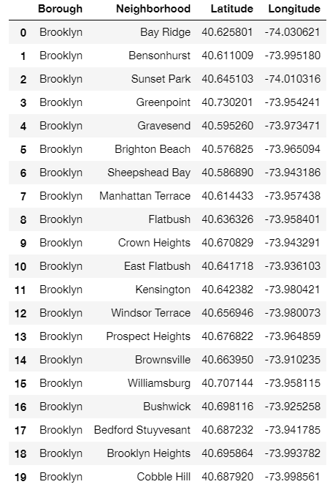
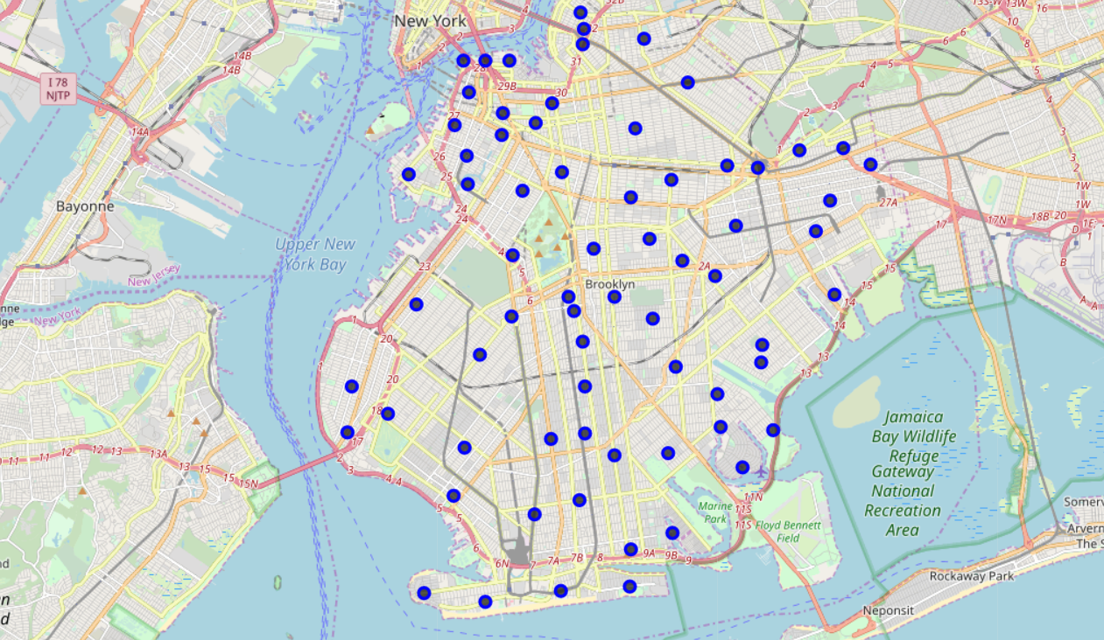
Brooklyn Map - Neighborhoods and Cluster of Venues

Slide 5
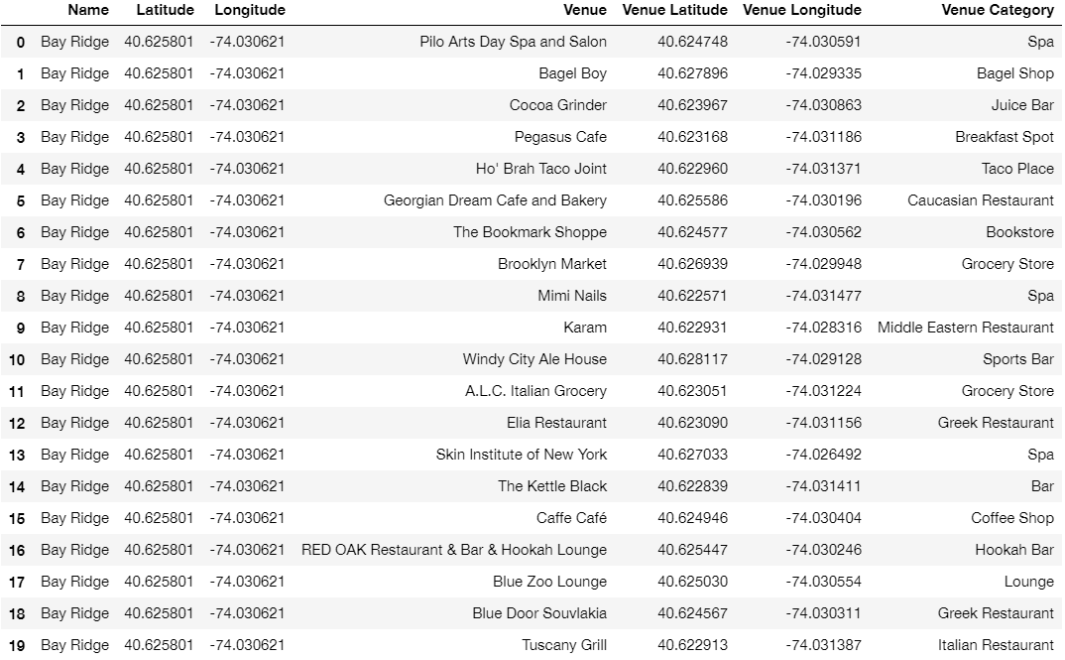
Brooklyn Map – Venues’ Categories

Slide 6
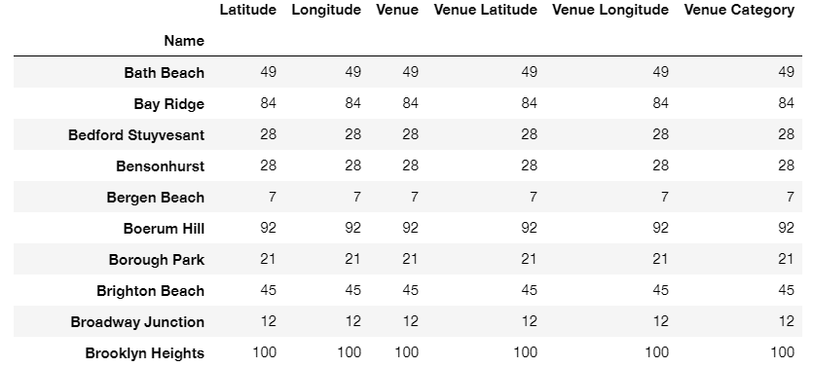
Brooklyn Map – Venues’ Groups

Slide 7
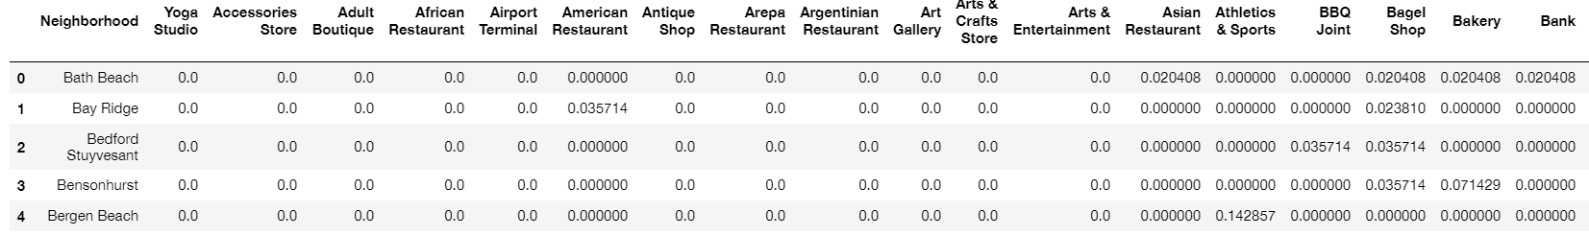
Brooklyn Map – Venues’ Groups

Slide 8
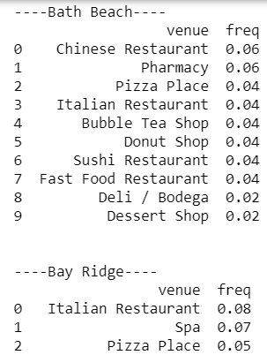
Neighborhood with top 10 most common venues

Slide 9
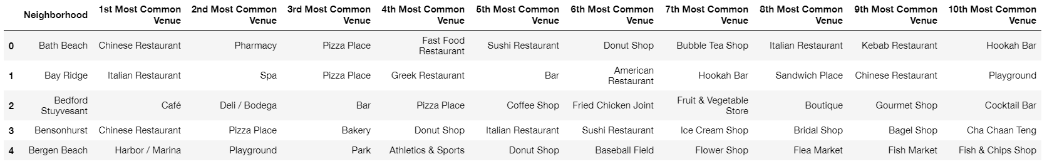
Top 10 venues for each neighborhood

Slide 10
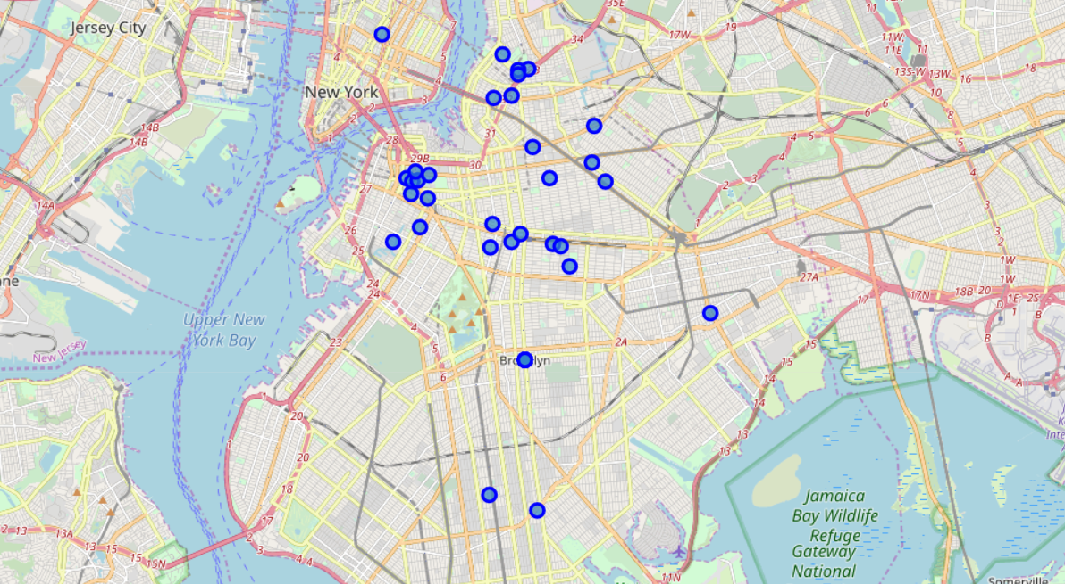
GeoData Brooklyn apartments for rent

Slide 11
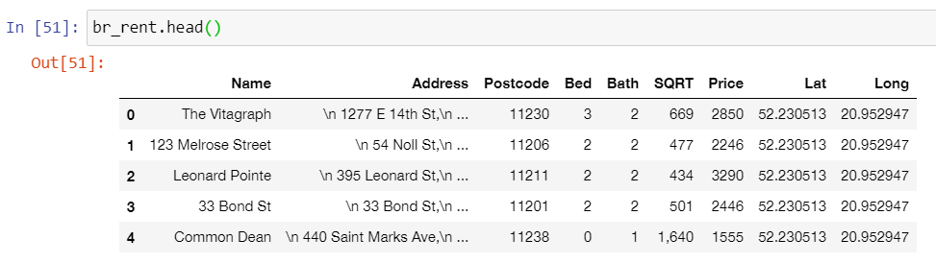
GeoData Brooklyn apartments for rent

Slide 12
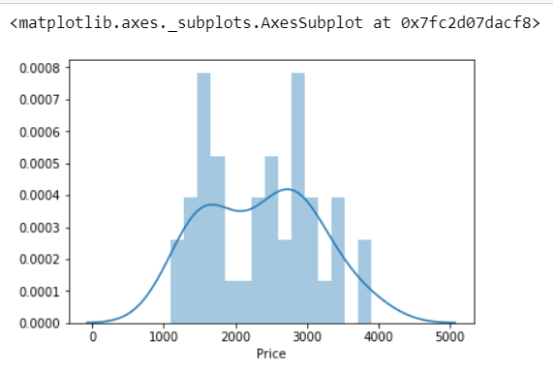
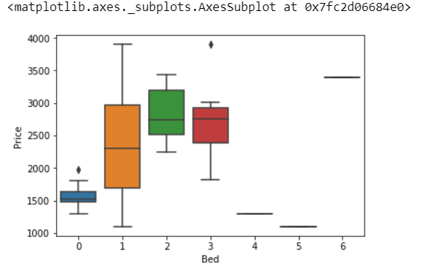
Rental Price Statistics BR Apartments Budget US5000/month is around the mean

Slide 13
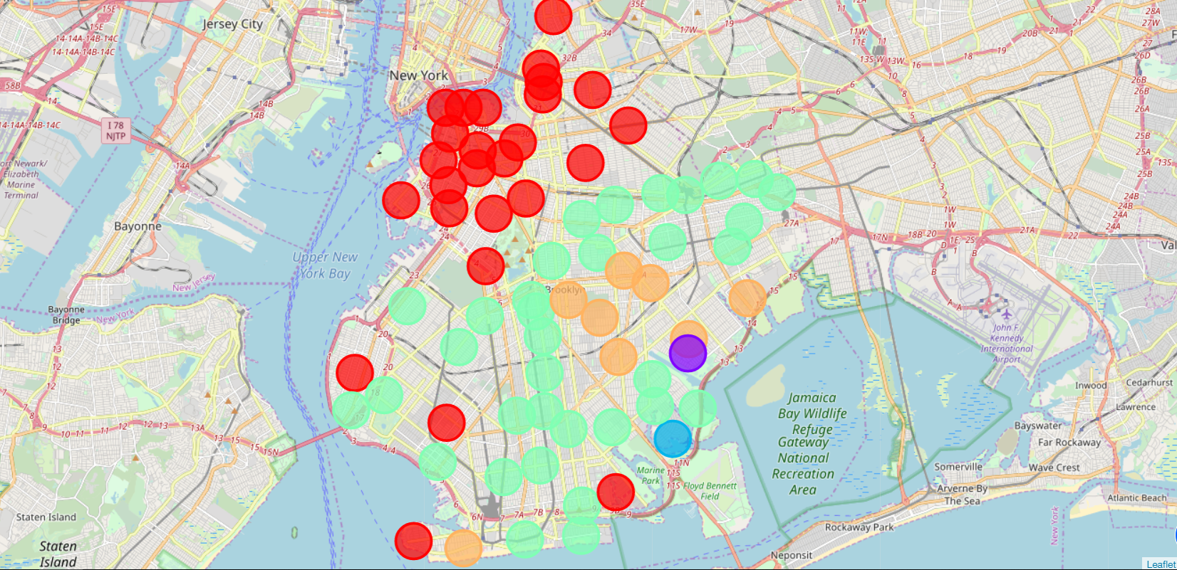
BR apartments’ venue clusters

Slide 14
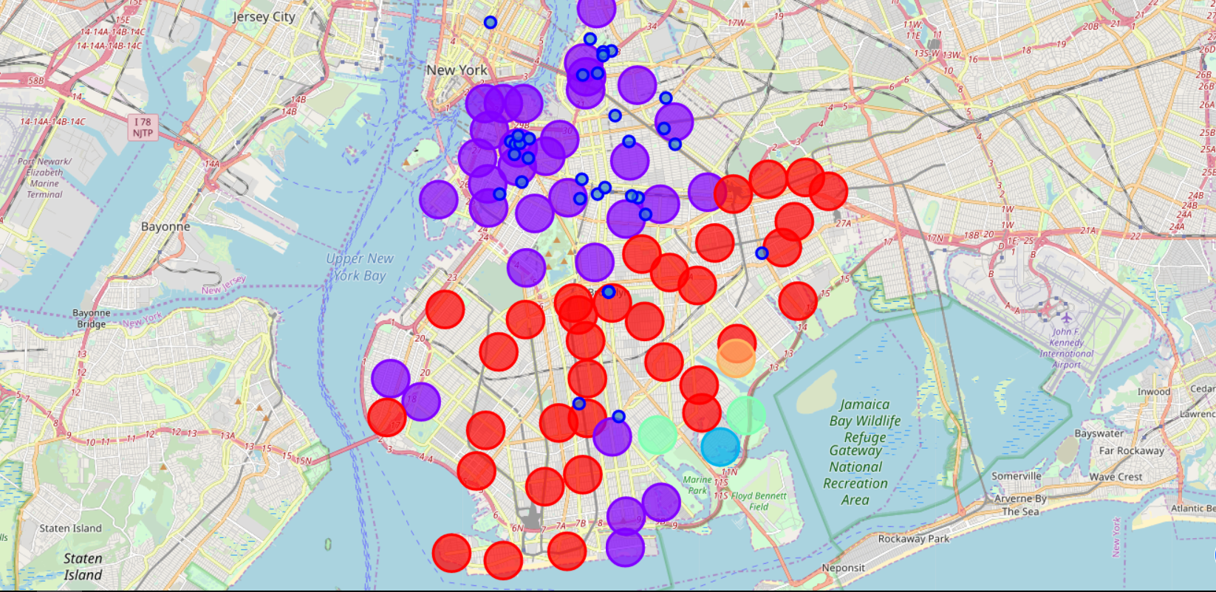
BR apartments for rent with venue clusters

Slide 15
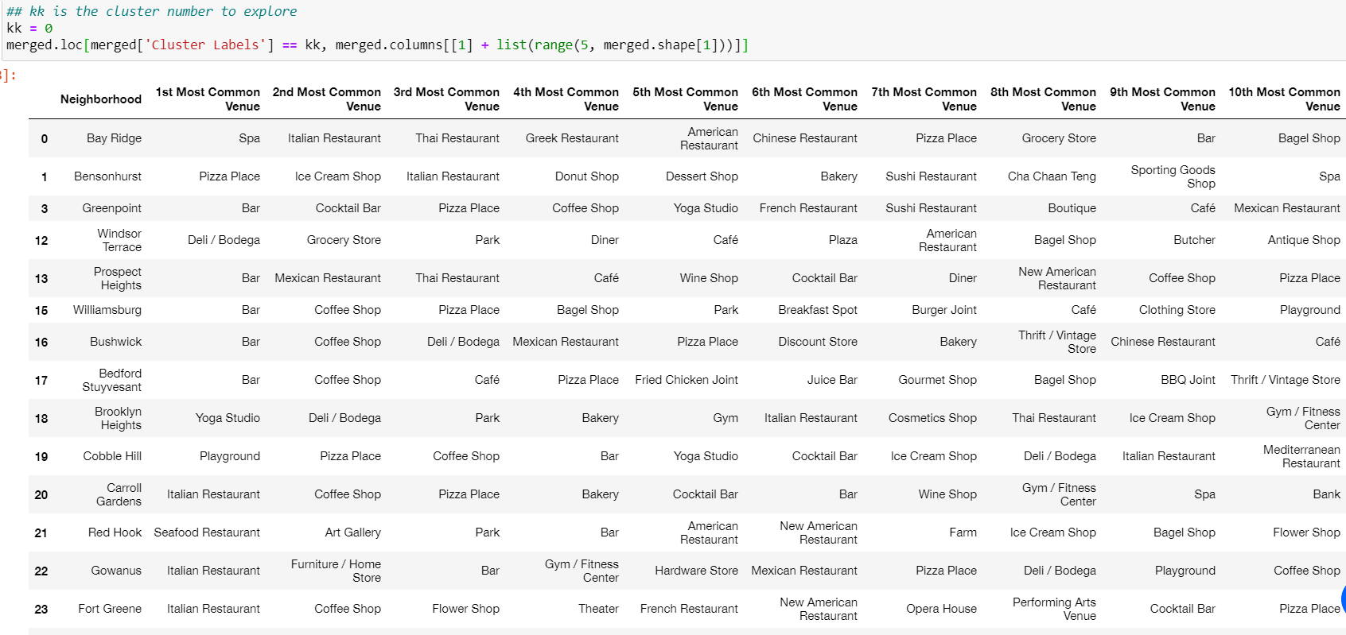
Venues of cluster 0

Slide 16
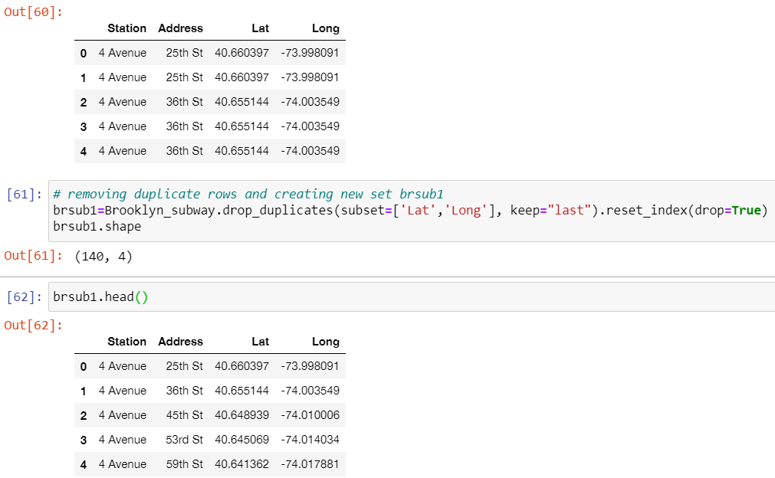
Brooklyn subway stations geodata

Slide 17
Apartment Selection
I was able to explore all possibilities since the popups provide the information needed for a good decision.
Apartment 1 and 2 rent cost is 3445$ and 3440$. Venues for this apartments are as of Cluster 0 and it is located in a fine district in the West side of Brooklyn.
Based on current Istanbul venues, I feel that Cluster 0 type of venues is a closer resemblance to my current place.

Slide 18
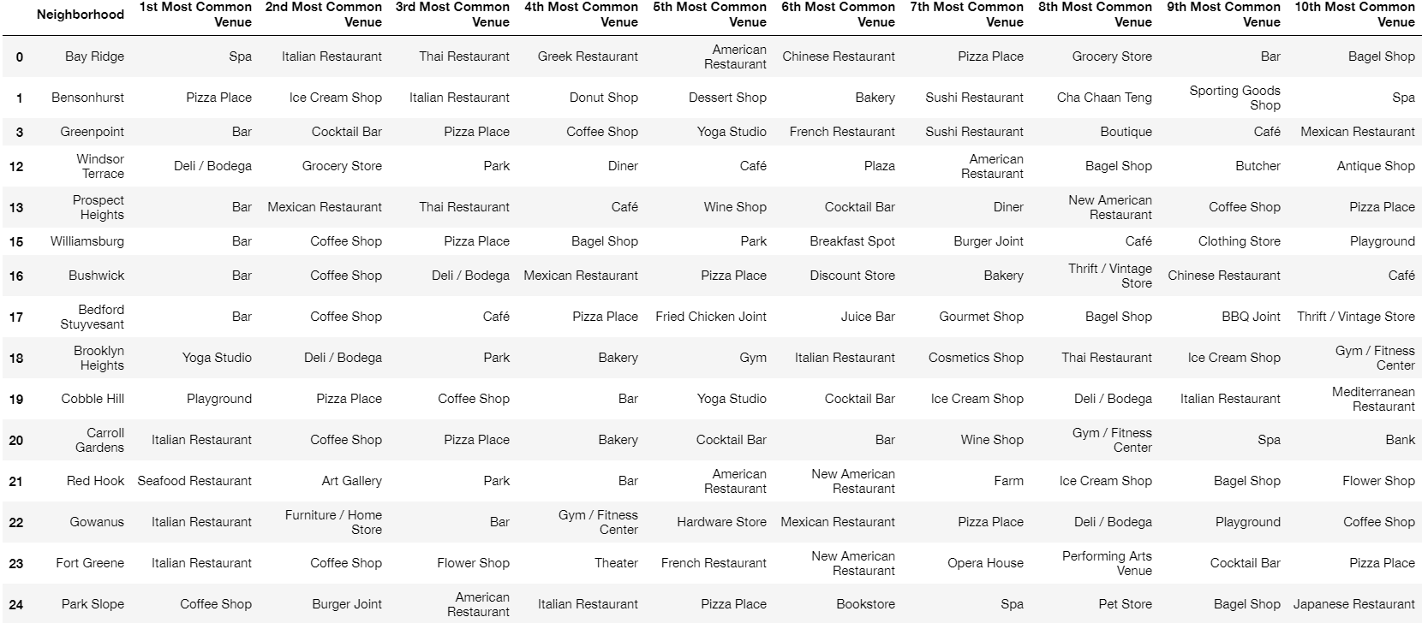
544 Union in Cluster 0 near future home

